Slide 1
PARLER
A Data-Driven Exploration of the Lead-up to January 6, 2021
Magdalena Breyer

Slide 2
01
TABLE OF CONTENTS
02
03
04
BACKGROUND
What is Parler? Why is it important?
RESEARCH QUESTIONS
Could data analysis have warned of January 6?
FINDINGS
Clustering, Topic Modelling, and Time Analysis
CONCLUSION
Themes, Limitations, and Future Research

Slide 3
01
PARLER
AND THE LEAD-UP TO JANUARY 6

Slide 4
What is Parler?
Alt-right social media platform

Slide 5
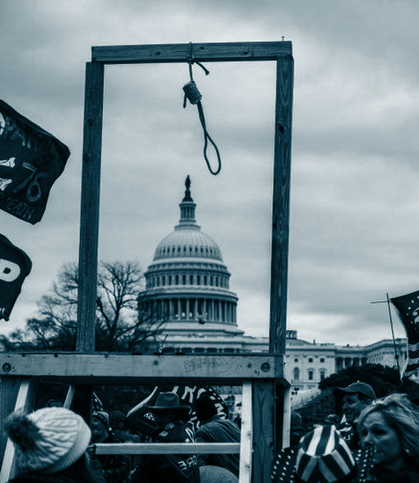
Relationship to January 6, 2021

Slide 6
02
RESEARCH QUESTIONS
What insights do clustering algorithms reveal about the underlying structure and themes of text posts on the Parler platform?
Are there distinct ideological clusters and thematic patterns within the text of parleys?
How did the trends in hashtags, topics, and posting patterns within the Parler community change over time, specifically from July 2020 to January 2021?

Slide 7
3. FINDINGS

Slide 8
1.1 CLUSTERING
What insights do clustering algorithms reveal about the underlying structure and themes of text posts on the Parler platform?
CLUSTER 1
CLUSTER 2
CLUSTER 3
votes, explanation, negative, explained, david, taken, georgiathey, perdue, live, still
let, follow, biden, wtf, us, georgia, live, fraud, see, yes
people, wow, must, thank, west, wing, hear, right, oval, office
CLUSTER 4
CLUSTER 5
CLUSTER 6
perdue, vote, votes, georgia, loeffler, warnock, ga, thousand, lead, see
expecting, holy, cow, america, covid, kamala, harris, king, constitutional, time
trump, echo, dc, president, follow, patriots, election, watch, georgia, tomorrow

Slide 9
CLUSTERING
CONTINUED
CLUSTER 7
CLUSTER 8
go, italy, enough, constitution, obama, election, us, politicians, pm, results
citizen, press, free, plaza, speaking, take, flynn, live, freedom, watch
CLUSTER 9
CLUSTER 10
biblical, worth, words, starting, maga, thanks, think, bastard, remember, need
presiding, swear, lt, democratic, session, remove, majority, gov, senator, pennsylvania

Slide 10
1.2 TOPIC MODELLING
Topic 1: trump president maga election stopthesteal tomorrow america patriots freedom patriot
Topic 2: history know story everyone kamala harris told civil please rights
Topic 3 : state votes election trump call president thank states pence right
Topic 4: georgia votes county got warnock election fraud abrams biden dekalb
Topic 5: dc patriots trump romney watch traitor flight echo police see
Topic 6: dc going people trump president time us today take american
Topic 7: trump echo follow name hidden votes senate biden pennsylvania maga
Topic 8: trump election serremmy news video president pennsylvania thousand georgia votes
Topic 9: god us like faith people name never government election win
Topic 10: follow echo let county enough georgia ballots fulton court order

Slide 11
THEMATIC AND IDEOLOGICAL PATTERNS
TOPIC 1 | Political themes related to President Trump, the MAGA movement, and election sentiments like "stop the steal"
TOPIC 2 | Historical aspects, civil rights, and possibly Kamala Harris's role in the political landscape
TOPIC 4 | Election issues in Georgia, including allegations of fraud and specific candidates like Warnock.
TOPIC 7 | Centers on election news, videos, and states like Pennsylvania and Georgia.
TOPIC 8 | Words related to faith, government, and winning, reflecting White Christian nationalist narratives

Slide 12
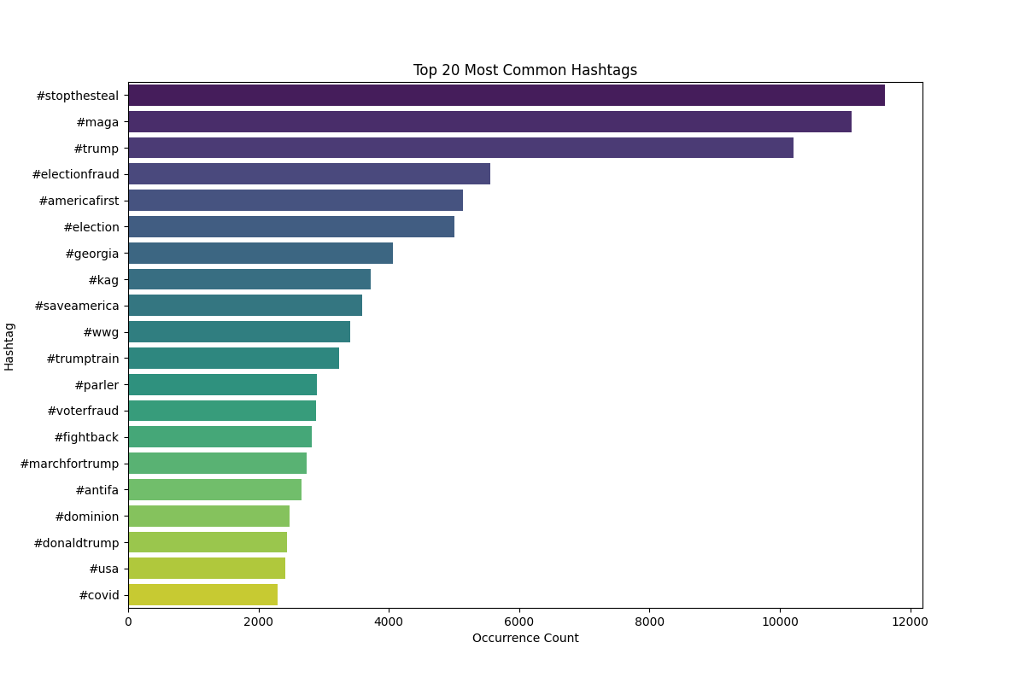
1.3
1.3 Trend Analysis

Slide 13
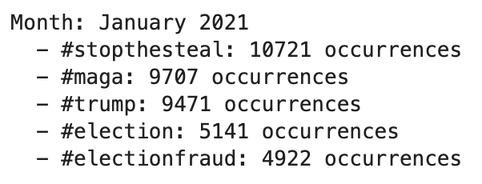
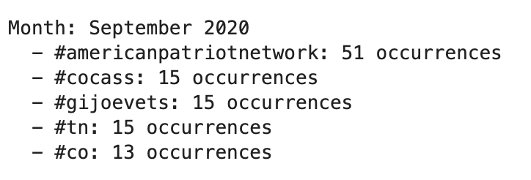
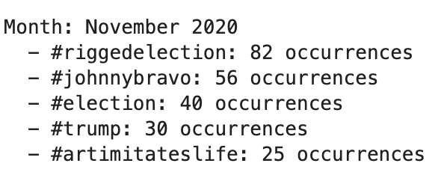
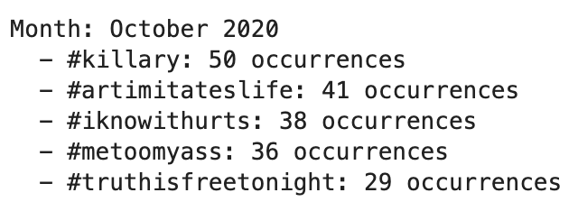
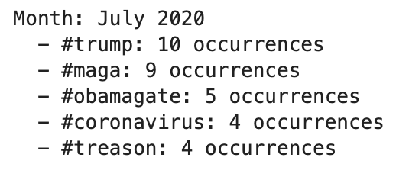
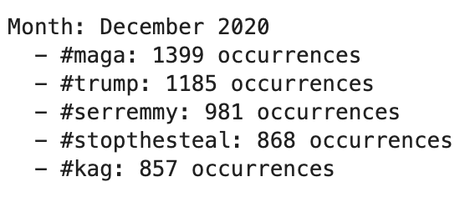
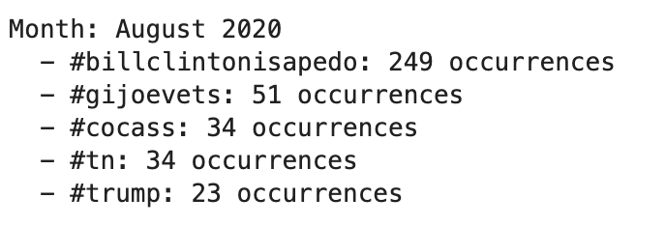
HASHTAG TRENDS

Slide 14
LDA TRENDS
November, 2020: Topics related to "hidden name," "Killary," "election," "Epstein," and more.
December, 2020: Topics about Chinese connections, Hunter Biden, masks, vaccines, and more.
January, 2020: Topic related to “MAGA," "KAG," "follow," "comment," "caboose," "WWG," "serremmy,"

Slide 15
CONCLUSION
THEMES
LIMITATIONS
FUTURE RESEARCH
Increase in Activity Frequency
Call-to-Action
Trumpism
Homogenous
No Longer Exists
Ineffective Clustering
Social Network Analysis
Sentiment Analysis
Other Social Media Platforms

